Slide 1
Online Shopper’s Intention
Team 3 - 심우석, 이민서, 고효진

Slide 2
TABLE OF CONTENTS
01
04
02
05
03
06
Objective
Algorithm
Problem Statement &
Business Objective
Classification & clustering algorithm and it’s features
Data Description
Evaluation
Statistical description
of the dataset
Evaluate the results
Preprocessing
Schedule
Data Preprocessing
Estimated schedule and collaboration plan

Slide 3
01
Objective
Problem statement & Business objective

Slide 4
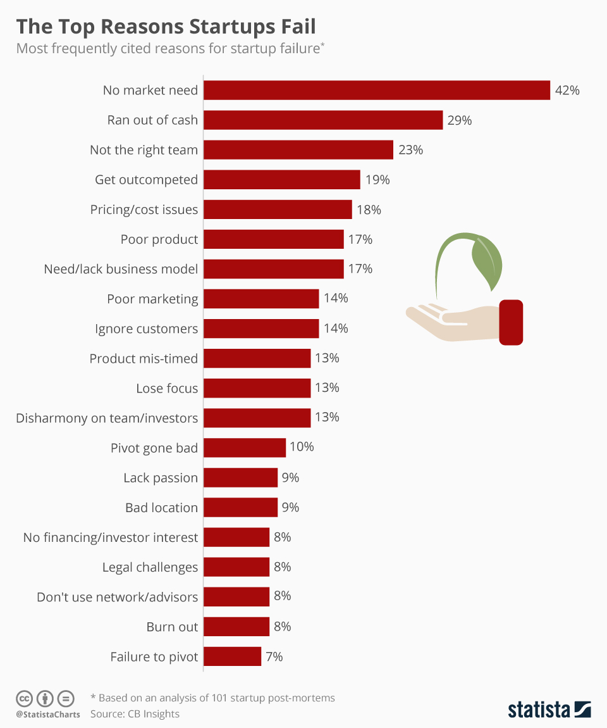
Objective
Due to the nature of online transactions, it is difficult to receive professional consulting because there are many sole proprietorship.
Therefore, it is difficult for them to grasp the demand of the market, and as a result, many businesses fail.
https://www.statista.com/chart/11690/the-top-reasons-startups-fail/

Slide 5
Objective
Due to the nature of online transactions, it is difficult to receive professional consulting because there are many sole proprietorship.
Through this project, The e-commerce company can identify consumer’s behavior patterns and identify factors that affect sales. And based on this, they can lead consumers’ purchases and expand their online business.

Slide 6
02
Data Description
Statistical description
of the dataset

Slide 7
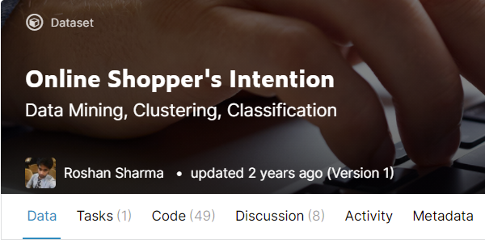
Data Description
Online Shoppers Purchasing Intention Dataset from UCI’s
Kaggle: https://www.kaggle.com/imakash3011/online-shoppers-purchasing-intention-dataset

Slide 8
Online Shopper’s Purchasing Intention
The dataset consists of feature vectors (Rows) belonging to 12,330 sessions.
The dataset was formed so that each session would belong to a different
user in a 1-year period to avoid any tendency to a specific campaign,
special day, user profile, or period.
The dataset consists of 10 numerical and 8 categorical attributes.
Data is 12,330 rows * 18 columns.
The ‘Revenue’ attribute is the class label (target value)

Slide 9
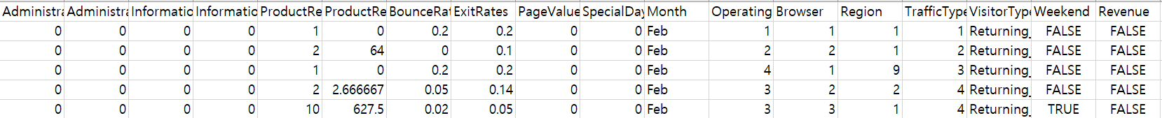
Data Description
Administrative, Administrative Duration, Informational, Informational Duration, Product Related, Product Related Duration, Bounce Rate, Exit Rate, Page Value, Special Day, Browser, Region, Traffic Type, Visitor Type, Weekend, Operating Systems, Month is feature value.
Revenue is target value.
The ratio of target data is 84.5% - False (10,422), True (1908)

Slide 10
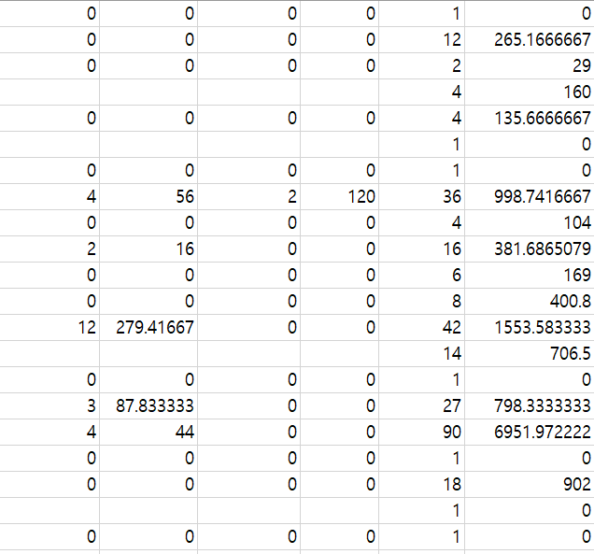
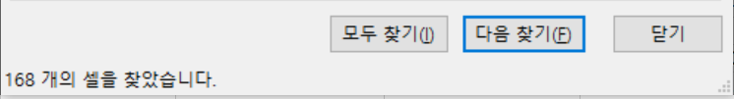
Online Shopper’s Purchasing Intention
Missing value - Administrative, Administrative_Duration,
Informational, Informational_Duration,
ProductRelated, ProductRelated_Duration,
BounceRates, ExitRates. - Total number [168]

Slide 11
Data Description
Feature Name | Data type | Feature Description
Administrative | Integer | Number of different pages visited related to the administrative concerns of the website
Administrative Duration | Integer | Total amount of time (in seconds) spent by the visitor on account management related pages
Informational | Integer | Number of different pages visited related to the information of the website and other useful contents of the website
Informational Duration | Integer | Total amount of time (in seconds) spent by the visitor on informational pages
Product Related | Integer | Number of different pages visited to different products of the website
Product Related Duration | Integer | Total amount of time (in seconds) spent by the visitor on product related pages
Bounce Rate | Float | Average bounce rate value of the pages visited by the visitor
Exit Rate | Float | Average exit rate value of the pages visited by the visitor
Page Value | Float | Page Value is the average value for a page that a user visited before making a transaction
Special Day | Float | The “Special Day” feature indicates the closeness of the site visiting time to a specific special day
Numerical Features -

Slide 12
Data Description
Categorical Features -
Feature Name | Data type | Feature Description
Browser | Integer | ID of browsers from which the session took place.
Region | Integer | ID of regions from which the session took place
Traffic Type | Integer | ID of different types of sources from which the users landed on the website
Visitor Type | String | Visitor type as “New Visitor”, “Returning Visitor” and “Other”
Weekend | Boolean | Whether the session was on a weekend or not
Operating Systems | Integer | Operating system of the visitor
Month | Boolean | Month value of the visit date
Revenue (Target Value) | Boolean | Whether the user contributed to the revenue by purchasing or not

Slide 13
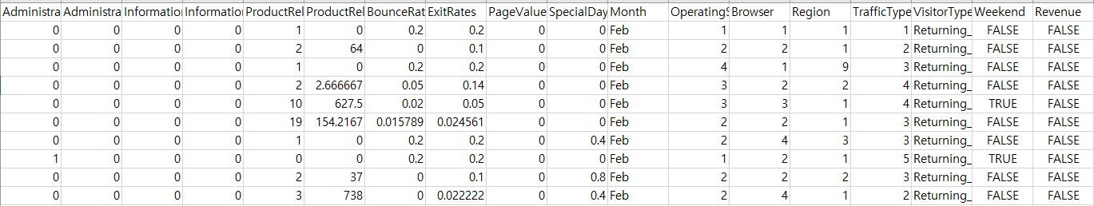
Data Description
Dataset head -

Slide 14
03
Preprocessing
Data Preprocessing

Slide 15
Data Preprocessing
Cleaning Dirty Data -
Missing, Wrong, Unusable Data (Replace it)
2. Outlier detection -
Using the Z-score (numerical)
and Box-plot (categorical)

Slide 16
Data Preprocessing
3. Data Encoding –
Using Ordinal, Label Encoding
4. Data Scaling -
Using Standard, MinMax, MaxAbs, Robust

Slide 17
Feature selection
Classification -
Using the SelectKBest,
RFE(recursive feature elimination)
Clustering -
Using the PCA, Feature random select,
The combination that we set up

Slide 18
Re-weight The unbalanced Target data
Re-weight the unbalanced Target Data
The ratio of target data is 84.5% -
Negative (10,422), Positive (1908)
Using the SMOTE re-weight positive value
(Synthetic minority oversampling technique)

Slide 19
04
Algorithm
Classification & clustering algorithm and it’s features

Slide 20
Classification
Algorithms for classification
1. Logistic Regression
2. Gradient Boosting Classifier
3. SVM(Support Vector Machine)

Slide 21
Classification
Influential feature list for classification
: BounceRates, ExitRates, PageValues, VisitorType
BounceRates - Percentage of users leaving without moving to other pages
ExitRates - Percentage of customers leaving the site after moving several pages
PageValues - Average value of the page they visited before completing e-commerce
VisitorType - Whether to reconnect
All four features are information such as whether the visitor revisited or stayed on the page. So, we expect these features to have the most influence on classification.

Slide 22
Clustering
Algorithms for clustering
1. MeanShift
2. KMeans
3. GMM (Gaussian Mixture Model) - EM

Slide 23
05
Evaluation
Evaluate the result

Slide 24
Evaluation
Classification -
Using the Precision, Recall, avg_total
Scores to select the best model.
Notes:
Clustering 부분에
3단계로 나눠서 한다는걸 따로 얘기해주면 좋겠습니다.

Slide 25
Evaluation
Clustering -
Three-step evaluation process. First, comparing using the silhouette score.
And then compare it once more using the purity score to select the best model. Finally, visualize the score.
Notes:
Clustering 부분에
3단계로 나눠서 한다는걸 따로 얘기해주면 좋겠습니다.

Slide 26
06
Schedule
Estimated schedule and collaboration plan

Slide 27
Schedule
MON | TUE | WED | THR | FRI | SAT | SUN
^{10/18} | ^{10/19} | ^{10/20} | ^{10/21} | ^{10/22} | ^{10/23} | ^{10/24}
^{10/25} | ^{10/26} | ^{10/27} | ^{10/28} | ^{10/29} | ^{10/30} | ^{10/31}
^{11/1} | ^{11/2} | ^{11/3} | ^{11/4} | ^{11/5} | ^{11/6} | ^{11/7}
^{11/8} | ^{11/9} | ^{11/10} | ^{11/11} | ^{11/12} | ^{11/13} | ^{11/14}
Data Preprocessing- cleaning dirty data, outlier detection, data encoding, data scaling
Model building- classification, clustering
Evaluation
Total Merge, Final PPT

Slide 28

Member Role
201636471 심우석
201835486 이민서
201935006 고효진
Data Preprocessing
Model Building
Final PPT
Model Building
Evaluation
Final PPT
Data Preprocessing
Evaluation
Final PPT

Slide 29

Github Term Project Page
Main : https://github.com/dntjr41/MachineLearning_termProject
Wiki : https://github.com/dntjr41/MachineLearning_termProject/wiki

Slide 30
THANKS
Do you have any questions?

